Slide 1


District Counselor Meeting
December 5, 2024

Slide 2


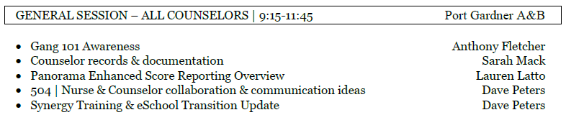
Today’s Agenda

Slide 3
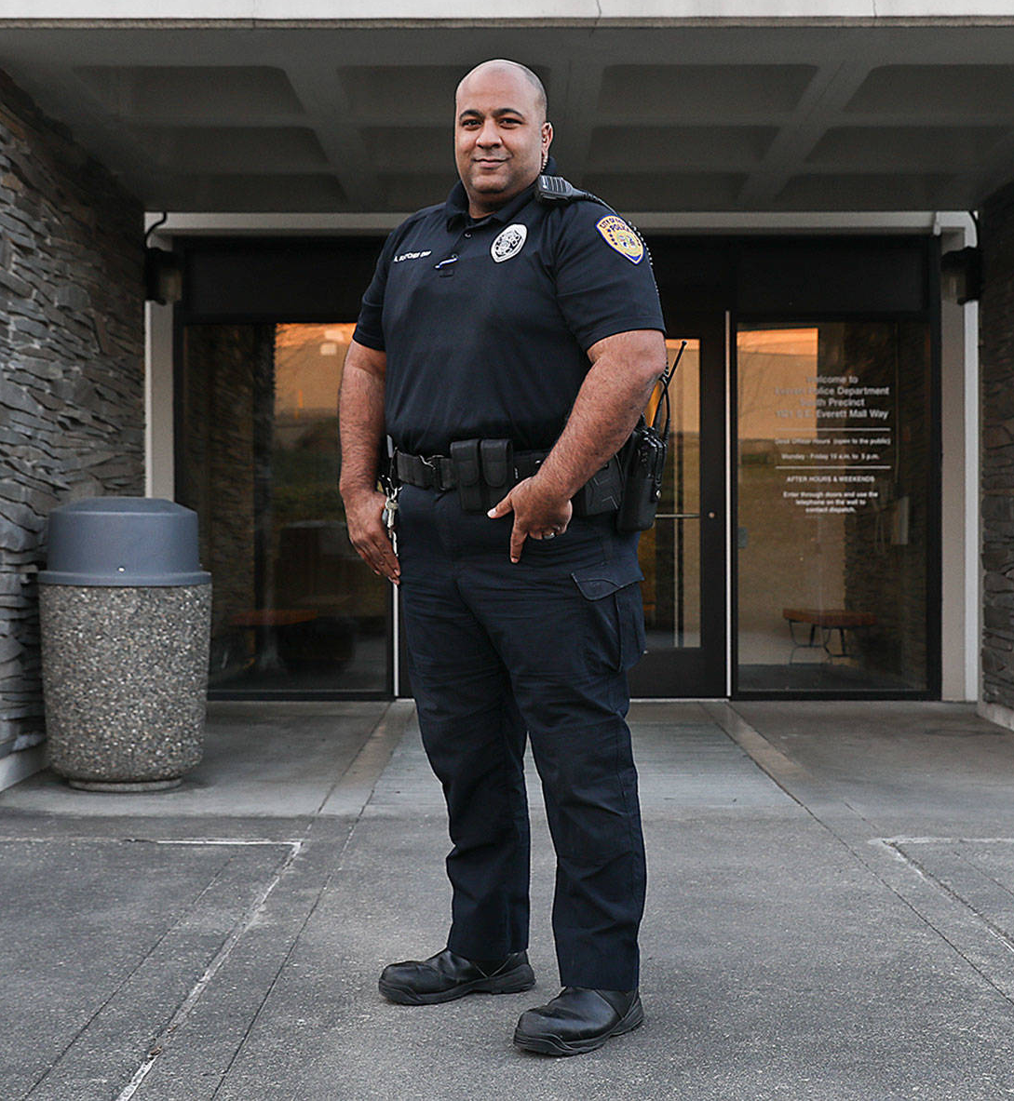
Gang 101 Awareness
Anthony Fletcher
Everett Police Department

Slide 4
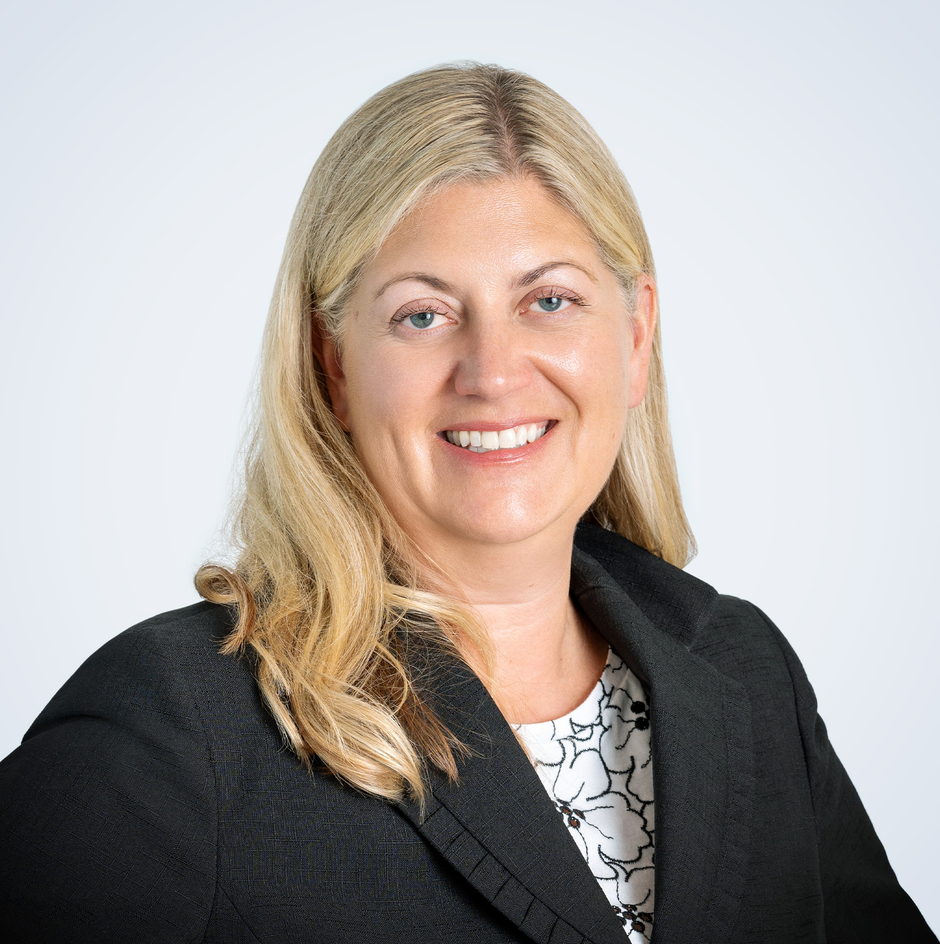
Counselor Records & Documentation
Sarah Mack
Everett Public Schools General Counsel

Slide 5

Panorama | Enhanced Score Reporting

Slide 6


Synergy | Trainer Sign Ups
Synergy Counselor Trainers
TIMELINES
Next fall, the transition will be complete from eSchoolPlus to Synergy as the EPS Student Information System. This spring, counselors will begin training in the respective components of the Synergy platform.
  Secondary Counselor Training Sessions | Feb. 21 - Student Schedule Management | April 17 - 504 Module (after the district counselor meeting)
  Elementary Counselors Training Sessions | April 17 - 504 Module (after the district counselor meeting)
TRAINING MODEL
In several cases, EPS will be utilizing a train-the-trainer model so that we can have built-in supports for school teams. Being a trainer will allow for earlier access to the Synergy platform and will deepen understanding & usage skills of each of the areas that counselors frequently utilize. The phrase, "You don't really understand something until you can explain it to someone else" will likely apply here.

Slide 7


Happy Holidays!

